Slide 1
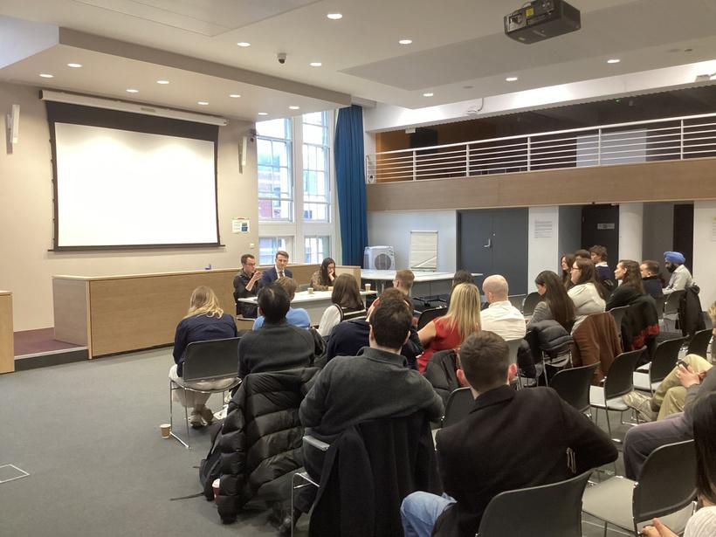


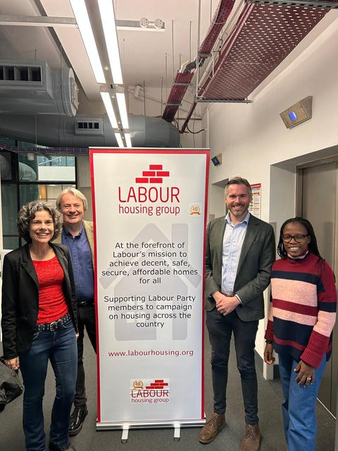
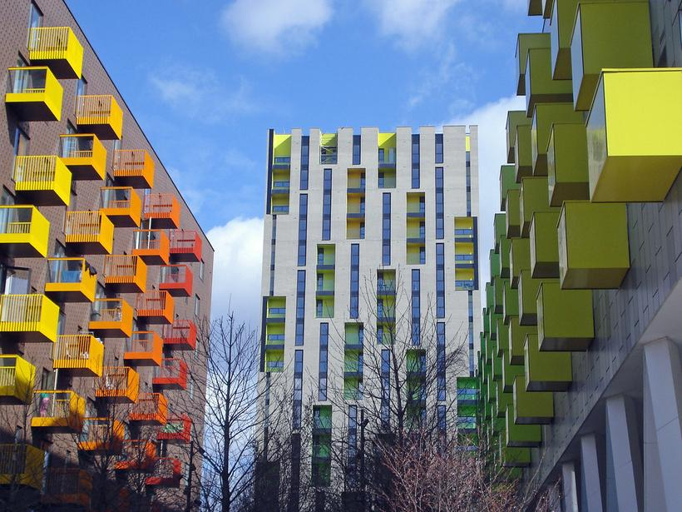
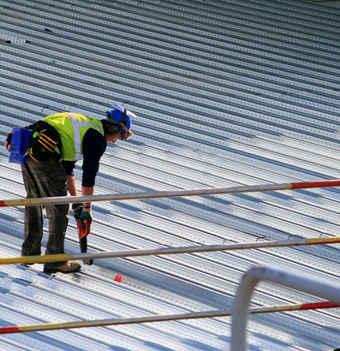
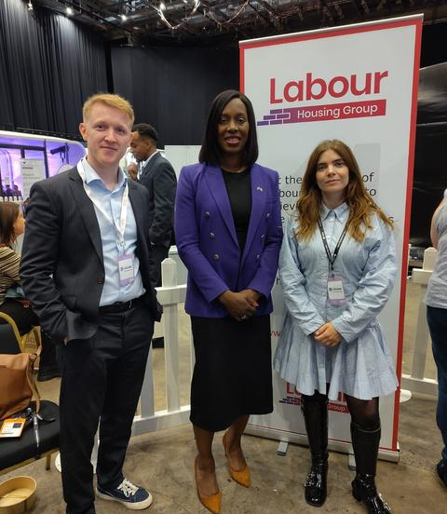

New Members’ Briefing
Tuesday 20 January

Slide 2
Agenda
1 | Welcome and introduction from LHG Chair Jack Shaw
2 | The benefits of LHG membership, with Membership Officer Heather Johnson
3 | LHG Policy and Working Groups, with Policy Officer Andy Bates
4 | The Homelessness Working Group, with Vice-Chair Alison Inman
5 | The Leasehold Reform Working Group and Red Brick, with Red Brick editor Alex Toal
6 | LHG Branches, LIGs, and Newsletter, with LHG Secretary Sheila Spencer
7 | Upcoming canvassing sessions
8 | Share your thoughts!

Slide 3

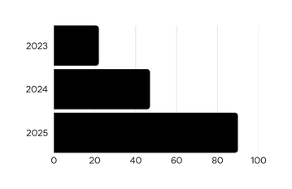




LHG in 2026
Welcome and introduction - LHG Chair Jack Shaw
Membership
In Conversation Events
Podcasts
450
10
12
Total increase
Total increase
Total increase
19%
20%
40%
New Blogs
New Patrons
Last year, we were proud to welcome four new patrons: Cllr Shama Tatler, Chris Curtis MP, Mayor Richard Parker, and Rachel Blake MP

Slide 4
Benefits of LHG Membership - Membership Officer Heather Johnson
Attend and vote at the AGM
Read the Red Brick blog
Attend our Policy Days
Attend our In Conversation Events
Listen to our podcast
Join our working groups
Set up or attend regional branch events
Contribute to policy debate and discussions
Propose campaign ideas
Receive our regular newsletter

Slide 5
LHG Policy and Events - Policy Officer Andy Bates
Annual Policy Days
Responding to Government Consultations
LHG Working Groups
  Building 1.5 million homes
  Leasehold Reform
  Social housing
  Homelessness

Slide 6
Social Housing Working Group
Improve the condition and management of existing social housing
Accelerate the building of new council housing
Empowering social housing tenants
Challenge the racist narrative on social housing allocations
We have responded to Government consultation on rent convergence and the decent homes standard

Slide 7
In-Conversation With
On-line discussion with politicians (Jess Phillips/ Helen Hayes), thinkers, (Matthew Taylor, Danny Dorling) academics (Hal Pawson) and practitioners (Paul Smith)

Slide 8
London Branch
Annual conference - Matthew Pennycook, Miatta Fahnbulleh, Rachel Blake, Adam Hug
Response to predominately London housing issues
Social- featuring Alex’s fiendishly difficult housing quiz

Slide 9
The Homelessness Working Group - LHG Vice-Chair Alison Inman
Bi-monthly meetings with experts and practitioners
What is the Government getting right on
homelessness? Where could it go further?
3 February - webinar on the National Plan to
End Homelessness

Slide 10

Red Brick and Leasehold Reform - Alex Toal
Red Brick is the official publication of Labour Housing Group
- Weekly articles on all topics related to housing
- Regular essay series on 10-year plan for housing and Class of 2024
- Volunteer opportunities in writing, editing and commissioning

Slide 11
LHG Rules and Structures - LHG Secretary Sheila Spencer
Branches
Local Interest Groups
LHG Newsletter

Slide 12
Upcoming Canvassing Sessions
Saturday 31st January (14:00): Lancaster Gate (Westminster), meeting at Waitrose and Partners, Porchester Road
Saturday 7th February (TBC) South Bermondsey (Southwark), meeting at Bermondsey tube station
Tuesday 17th February (18:00) Hillrise (Islington), meeting at The Great Indian, 139 Malborough Road - followed by a social at The Shaftesbury Tavern, Hornsey Road

Slide 13
What do you think?
Share your ideas and feedback!

